Slide 1
Performance Analysis and Match Insights: T20 World Cup 2026
:- POTHINENI NAVEEN

Slide 2
Project Goals
1.Performance Analysis of Teams.
2. Player Performance Evaluation.
3. Match Outcome Insights.
4. Over-wise Run Analysis.
5. Venue-Based Analysis.
6. Visualization & Reporting.

Slide 3
Description
This project analyzes data from the ICC Men's T20 World Cup 2026 to understand how teams and players perform during matches. The goal is to turn raw match data into useful insights that help explain:
Which teams are performing well
Which players are making the biggest impact
What factors influence match outcomes
Use following slides for discussing status, schedules, budget, etc.

Slide 4
Technology
1.SQL (Structured Query Language)
Used to analyze and extract insights from data
2.Power BI
Used to create visual dashboards
3.Data Source (Kaggle Dataset)
Provides real-world cricket match data

Slide 5
Data Cleaning & Preparation
1. Handling Missing Values
2. Removing Duplicates
3. Fixing Inconsistent Names
4. Data Type Correction
In this project, ICC MEN’S WORLD dataset was carefully cleaned and prepared before performing any analysis. Missing values were handled, duplicate records were removed, and team/player names were standardized to ensure consistency.

Slide 6
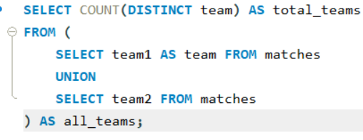



Total Participating Teams in World cup:-
Total venues:-

Slide 7
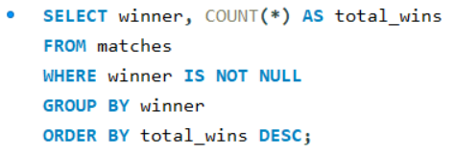
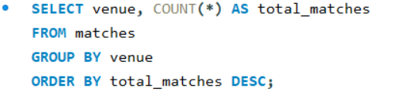
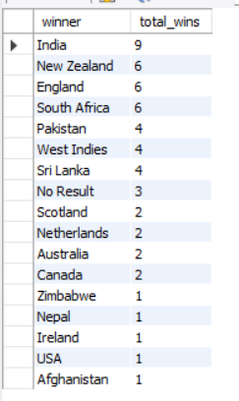
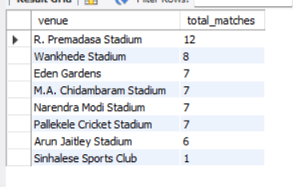
Most Successful Team
Venue-wise Match Count

Slide 8
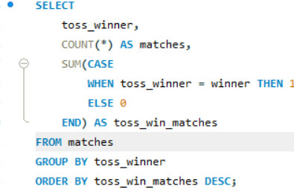
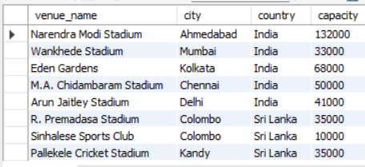
Venue located country and capacity

Slide 9
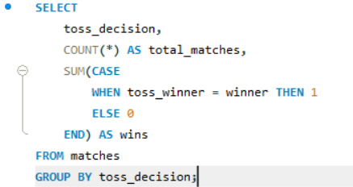
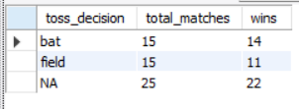
Bat First VS Chase First, wins
Teams batting first recorded a higher win percentage than teams bowling first.
Scoreboard pressure and pitch deterioration may contribute to this trend.
The data suggests batting first can provide a tactical advantage in T20

Slide 10
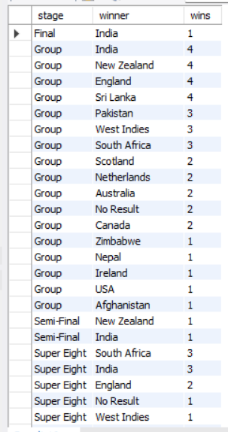
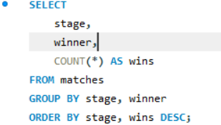
Stage performance analysis
Some teams dominated group stages but underperformed in knockout matches.
Successful teams maintained consistency under high-pressure situations.
Teams showed different performance levels across tournament stages.

Slide 11
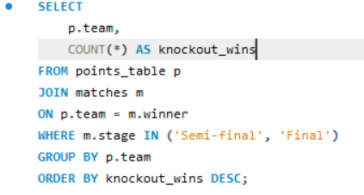

Teams Winning Most Under Pressure
Performance in knockout matches revealed a team’s ability to handle pressure, which proved more critical than group-stage dominance alone.

Slide 12
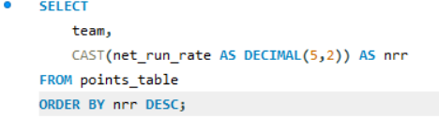
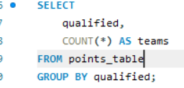
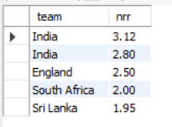
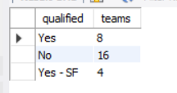
High Net Run Rate and Qualified teams

Slide 13
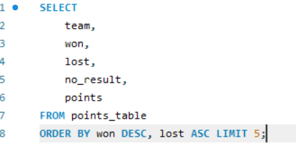
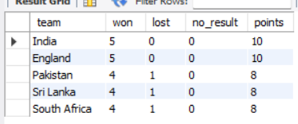
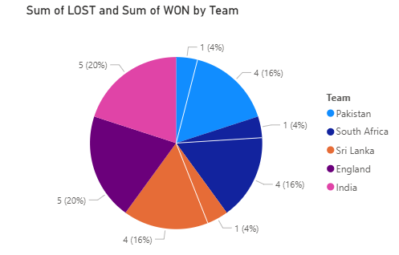
Most Concistent Teams
Team Consistency Analysis
Teams with consistent wins achieved higher tournament rankings.
Lower loss counts contributed significantly to qualification chances.
Consistency across matches was a key factor in overall tournament success.

Slide 14
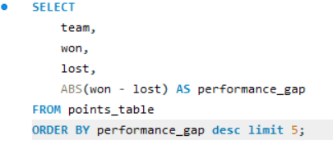
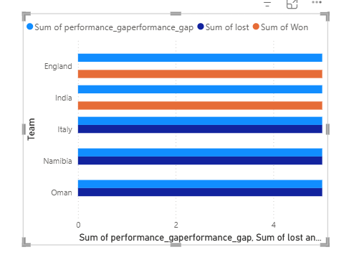
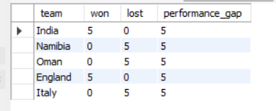
Top 5 Most compitative Teams
Competitive Team Analysis
Many teams showed closely balanced win-loss records.
Consistency in crucial matches played an important role in qualification outcomes.
Small performance differences significantly affected tournament rankings.

Slide 15
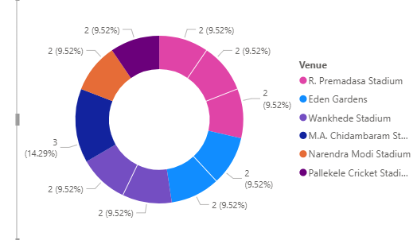
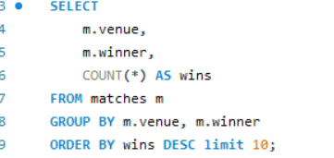
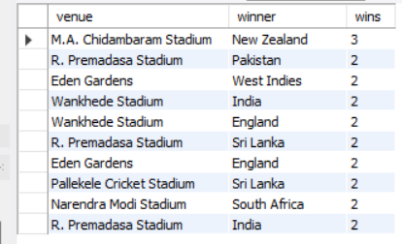
Venue Success Analysis
Venue conditions influenced match outcomes, making adaptability an important factor in tournament performance

Slide 16
Conclusion:-
Team consistency and strategic decisions strongly influenced tournament outcomes.
Toss decisions, venue conditions, and Net Run Rate impacted qualification chances.
SQL analysis helped uncover meaningful insights from tournament data.
This project demonstrates how data analysis can transform raw match statistics into meaningful strategic insights.
--THANK YOU

